Slide 1
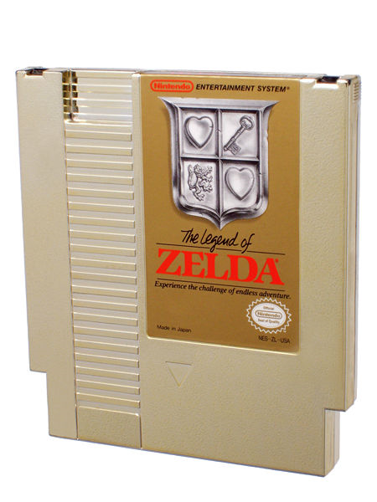
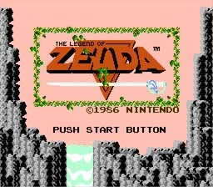
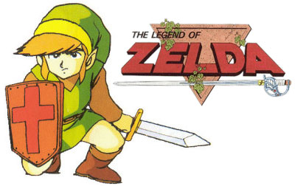
Legend of Zelda
1987
6.51 million sales
Notes:
In 1987 “Legend of Zelda” was Released
--http://www.consoleclassix.com/info_img/Legend_of_Zelda_NES_ScreenShot1.jpg [Top Left]
--http://tjzcheats.files.wordpress.com/2008/12/legend-of-zelda-nes.jpg [Bottom Left]
--http://www.listropolis.com/wp-content/uploads/2008/04/gold_zelda.jpg [Right]

Slide 2
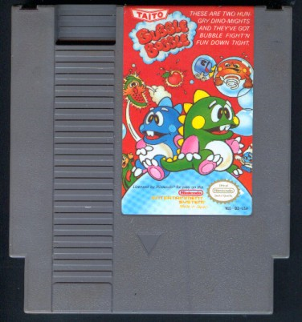
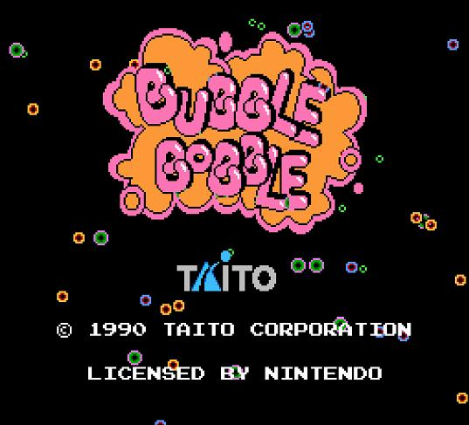
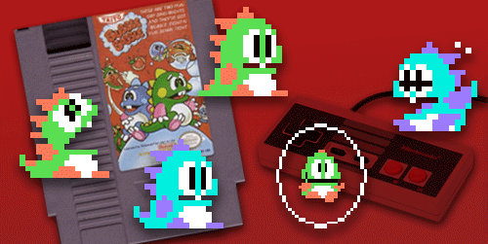
Bubble Bobble
1988
Notes:
In 1988 “Bubble Bobble” was released
--http://www.nes-site.com/shrines/bubble_bobble/cart.jpg [Top Left]
--http://casualtygamer.com/wp-content/uploads/2008/11/bubble-bobble.jpg [Bottom Right]
--http://www.jonnyrash.com/img/sandbox/bubble-bobble-dock-icon.png [Bottom Left]

Slide 3
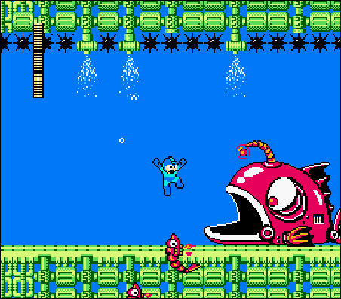
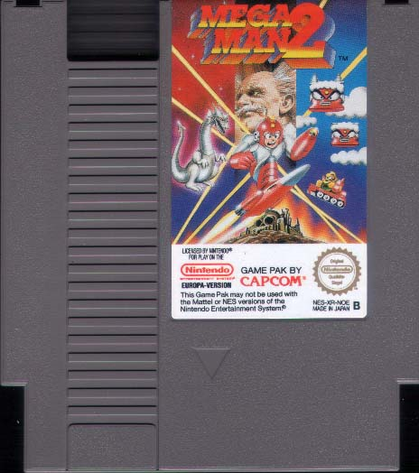
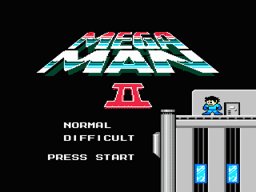
Mega Man 2
1989
1.5 million sales
Notes:
In 1989 “Mega Man 2” was released
--http://www.retrobrot.de/sammlung/images/nes/megaman2.jpg [Bottom Left]
--http://www.cyberiapc.com/vgg/stills/nes/megaman2_1.gif [Bottom Right]
--http://farm4.static.flickr.com/3008/2613784873_ac9f127b98_o.jpg [Top Right]

Slide 4
?
?
?
?
?
?
?????????
1990
?
?
?
?
?
?
?
Notes:
In 1990 what will be released?

Slide 5
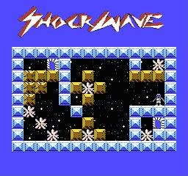
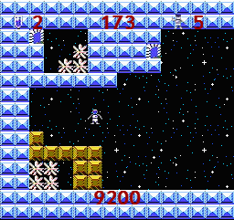
Working title
Shockwave
Working release date
1990
Notes:
Shockwave
A sci-fi puzzle game for the NES
--Taken from prototype [Top Left]
--Taken from prototype [Bottom Right]

Slide 6
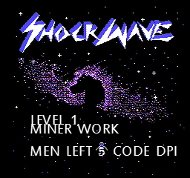
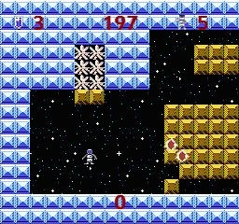
Genre
Puzzle
Platform
NES/Famicom
Notes:
To complete each level, in Shockwave, the player must move blocks about, in order to collect all the crystals, using shockwaves.

Slide 7
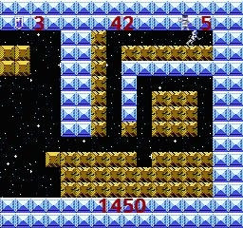
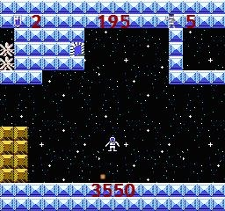
Simple controls
Time Limit
Persistent Score
Save Games
Notes:
Shockwave features:
Simple and intuitive controls,
A time limit per level,
A persistent high score from level to level,
Health and lives,
Bonus points for every second under the time limit,
Two player puzzle solving,
And a save game feature, allowing for continued play later

Slide 8
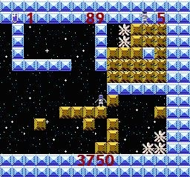
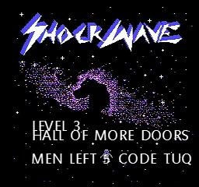
Challenging
Puzzles
Interactive
Scenery
Notes:
Unique to Shockwave is:
It’s puzzle solving, as there are few puzzle games available on the NES,
It’s interactive scenery, with destructible and moveable objects,
Also, unlike most NES games which are aimed at a low skill level, Shockwave challenges the player with it’s unforgiving puzzles and unexpected consequences from player actions.

Slide 9
Notes:
To develop this game, we ask for
3 seconds

Slide 10
7 staff (£72,450/year)
£507,150.00
Notes:
A staff of seven people,
3 seconds

Slide 11
7 staff (£72,450/year)
£507,150.00
7 computers (£618 per)
£4,326.49
Notes:
And seven computers,
3 seconds

Slide 12
7 staff (£72,450/year)
£507,150.00
7 computers (£618 per)
£4,326.49
NES (£112)
£112.47
Notes:
A NES for testing,
3 seconds

Slide 13
7 staff (£72,450/year)
£507,150.00
7 computers (£618 per)
£4,326.49
NES
£112.47
Marketing
£1,035,000.00
Notes:
A generous marketing budget,
3 seconds

Slide 14
7 staff (£72,450/year)
£507,150.00
7 computers (£618 per)
£4,326.49
NES
£112.47
Marketing
£1,035,000.00
Office Space (£51K + £24K)
£75,287.97
Notes:
And office space for seven,
3 seconds

Slide 15
Total Cost:
£1,624,876.93
Notes:
We predict then a total development cost of: £1,620,000

Slide 16
1.5 million sales
£39.99 (RRP)
£12.71 (Nintendo licensing fee)
£12.71 (Production costs)
£14.57 (Gross profit per unit)
Notes:
But with sales of 1.5 million in the first two years, a profit of

Slide 17
1.5 million sales
£39.99 (RRP)
£12.71 (Nintendo licensing fee)
£12.71 (Production costs)
£14.57 (Gross profit per unit)
£14.57 x 1,500,000 =
£20,233,123.07
(including development costs)
Notes:
Of over £20 million

Slide 18
500 thousand sales
£39.99 (RRP)
£12.71 (Nintendo licensing fee)
£12.71 (Production costs)
£14.57 (Gross profit per unit)
Notes:
But even with a reserved estimate of 500,000 sales, we calculate a profit of

Slide 19
500 thousand sales
£39.99 (RRP)
£12.71 (Nintendo licensing fee)
£12.71 (Production costs)
£14.57 (Gross profit per unit)
£14.57 x 500,000 =
£5,663,120.07
(including development costs)
Notes:
Of over £5.6 million

Slide 20

Notes:
Making Shockwave the right game to invest in.

Slide 21
From everyone at Selacious Software:
Thank you
Notes:
We thank you for your time.

